Slide 1
How to Crack Office Word Password

Slide 2
Introduction to Authentication

Slide 3
Authentication Methods
Something you know
password, bank card PIN
Something you have
SecureID token
Something you are
finger and iris scans

Slide 4
How are passwords stored?
Username: john
Password: hello

Slide 5
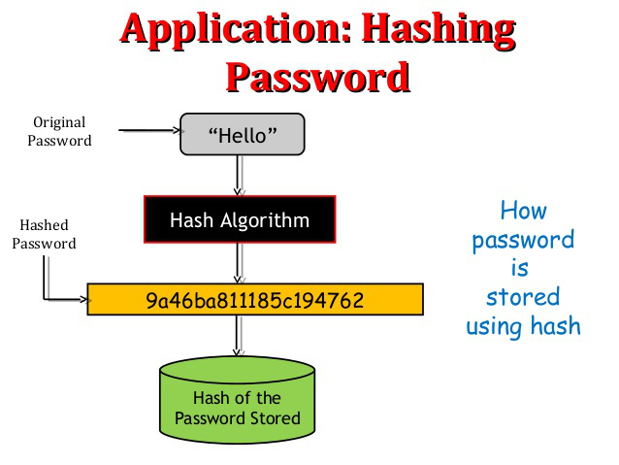
Password Hash

Slide 6
Required files for the lab

Slide 7
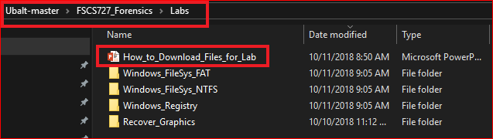
Following the PPTs to download required files for the lab

Slide 8
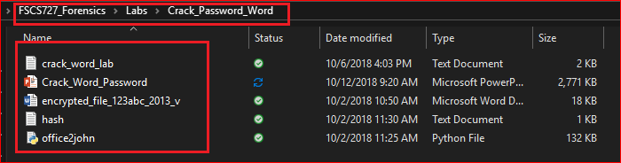
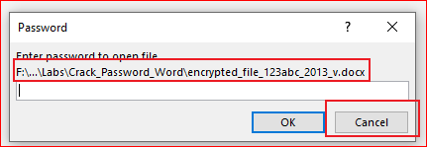
Verify the required files
Try to open the Word file

Slide 9
We are going to find the password!

Slide 10
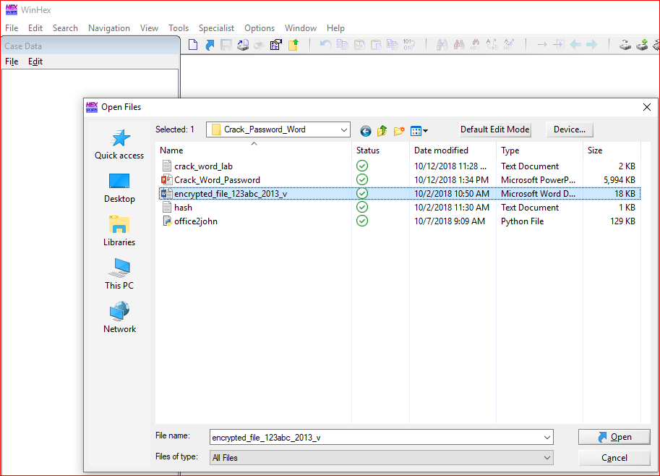

Slide 11
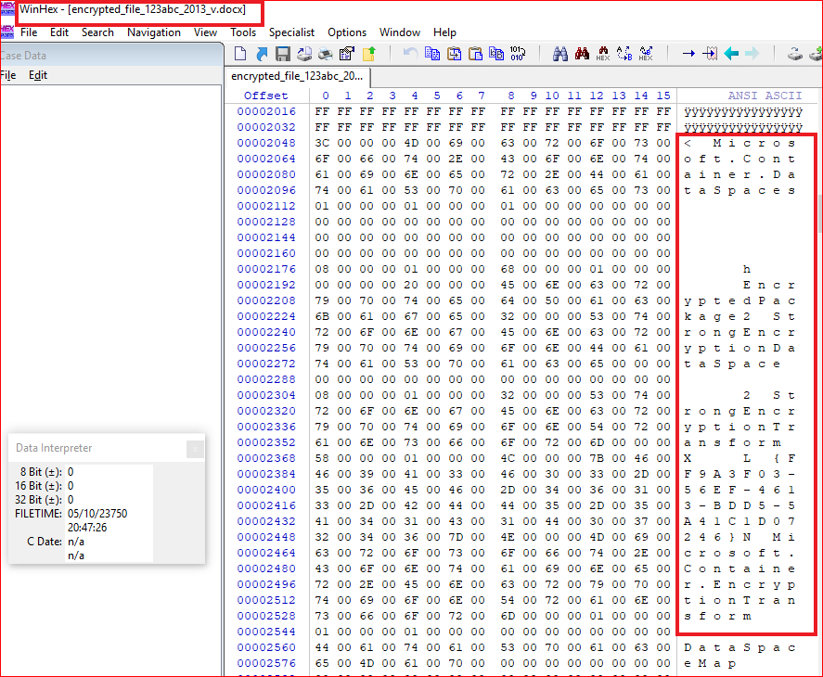

Slide 12
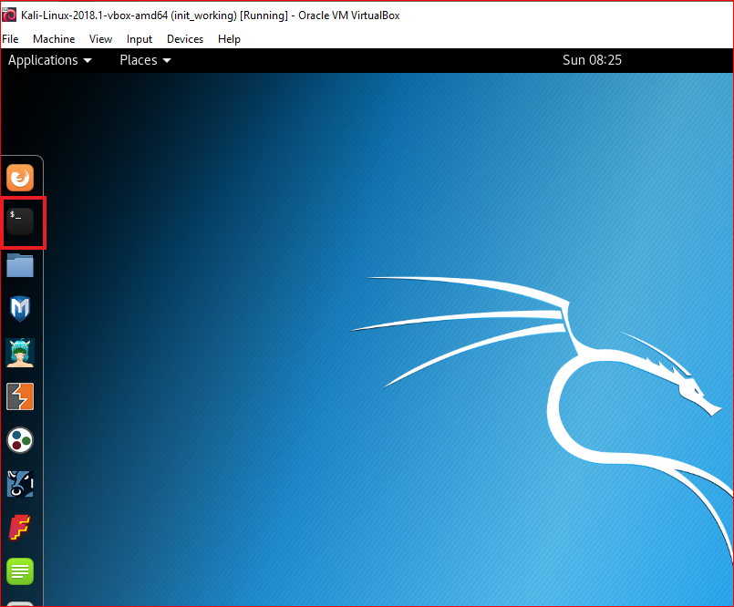
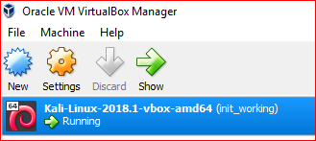

Slide 13
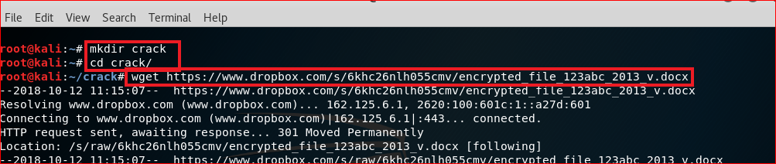
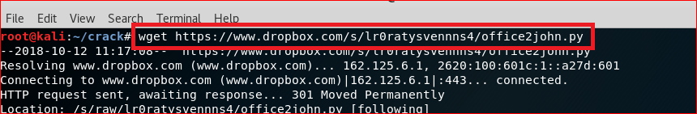
Download files
wget https://www.dropbox.com/s/6khc26nlh055cmv/encrypted_file_123abc_2013_v.docx
wget https://www.dropbox.com/s/lr0ratysvennns4/office2john.py

Slide 14
Extract Hash code of an encrypted Word file

Slide 15
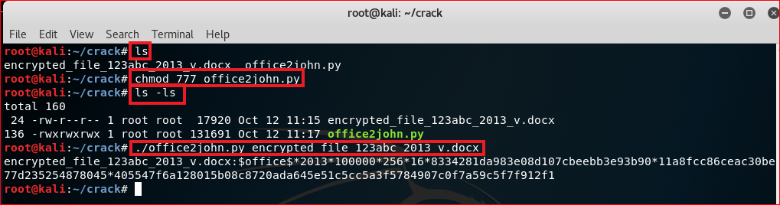
Use office2john to extract hash code from Word file’s header
encrypted_file_123abc_2013_v.docx:$office$*2013*100000*256*16*8334281da983e08d107cbeebb3e93b90*11a8fcc86ceac30be77d235254878045*405547f6a128015b08c8720ada645e51c5cc5a3f5784907c0f7a59c5f7f912f1

Slide 16
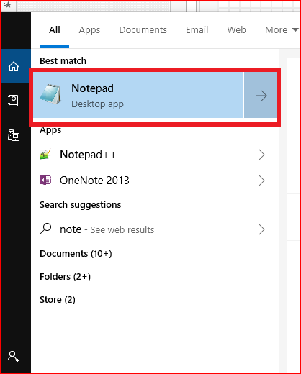
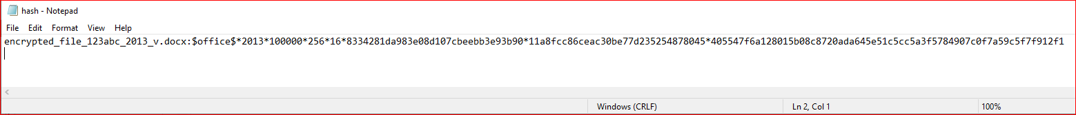
Copy the paste the hash code to hash.txt
encrypted_file_123abc_2013_v.docx:$office$*2013*100000*256*16*8334281da983e08d107cbeebb3e93b90*11a8fcc86ceac30be77d235254878045*405547f6a128015b08c8720ada645e51c5cc5a3f5784907c0f7a59c5f7f912f1

Slide 17
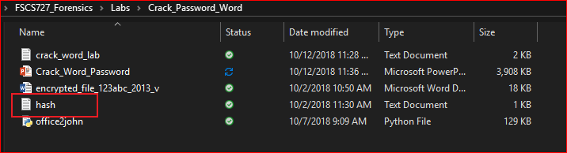
Verify

Slide 18
Install crack software

Slide 19
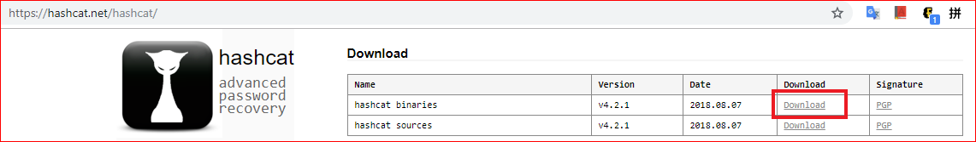
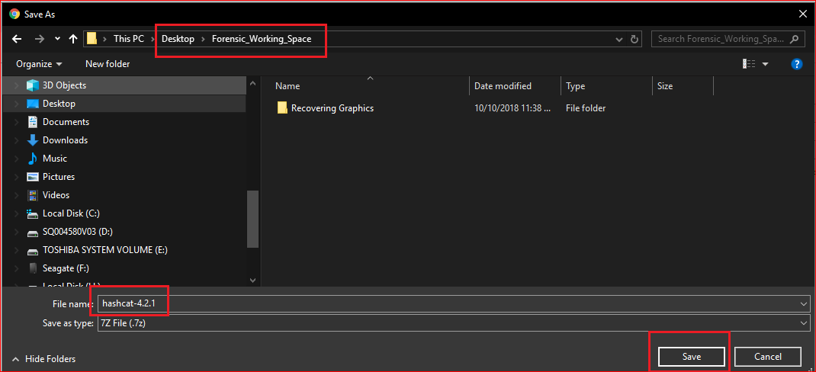
https://hashcat.net/hashcat/

Slide 20
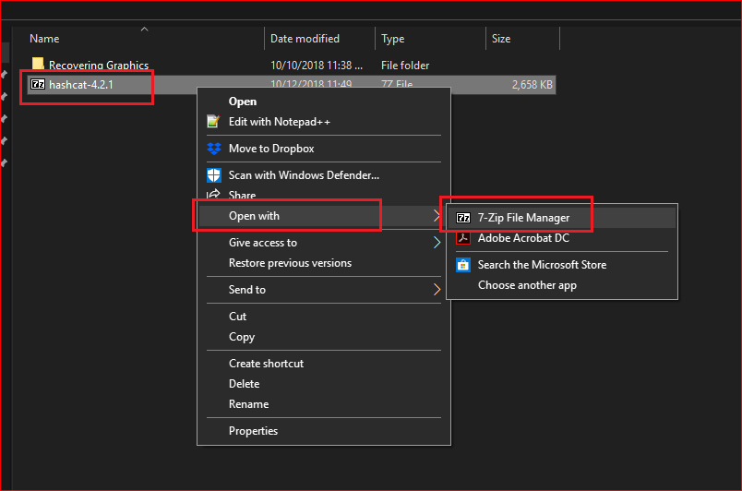

Slide 21
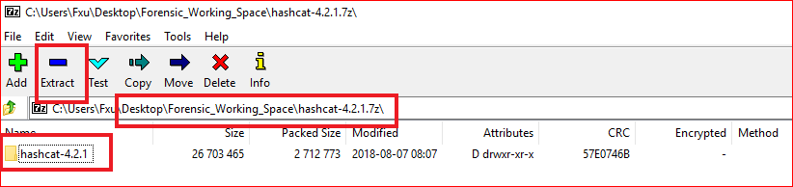
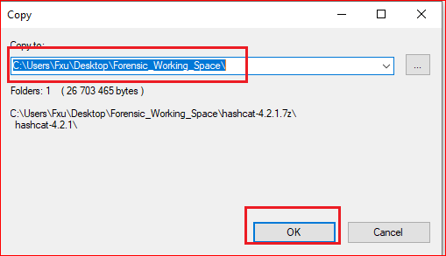

Slide 22
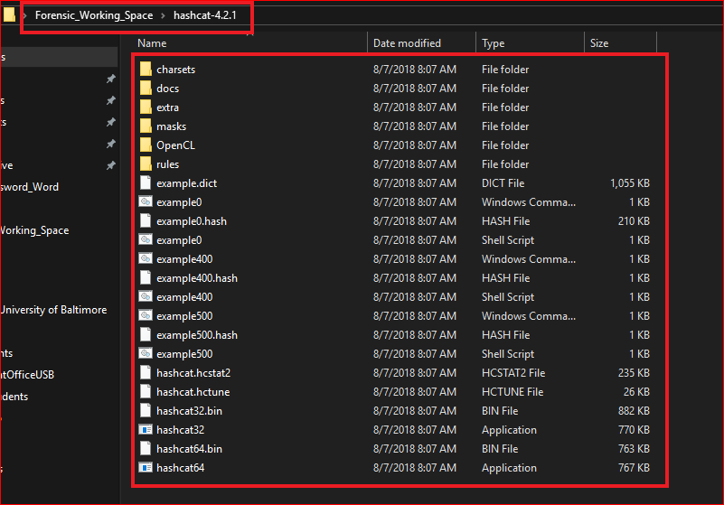

Slide 23
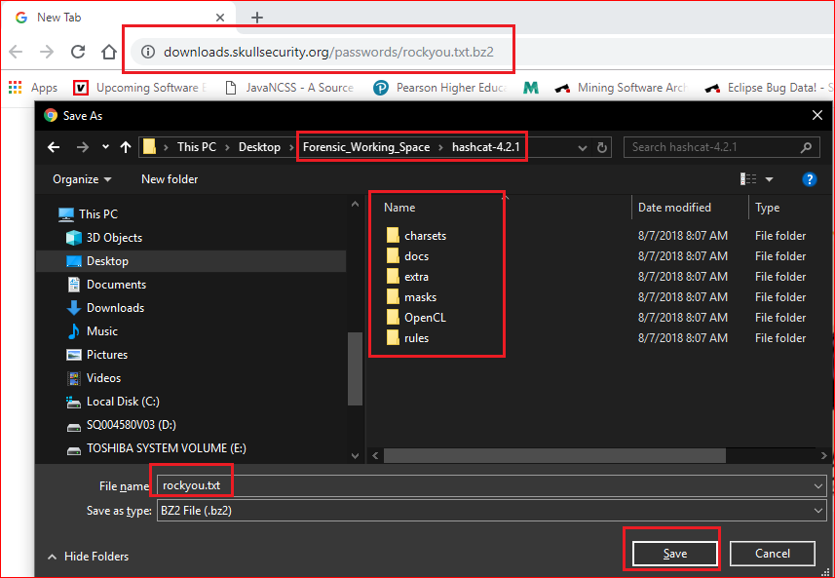

Slide 24
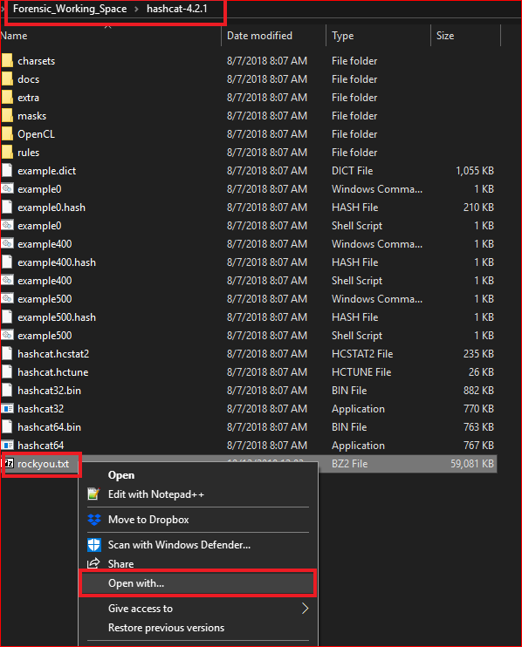
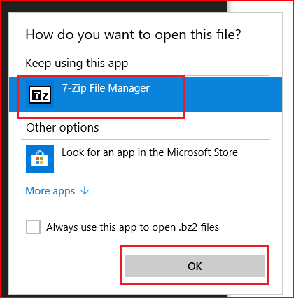

Slide 25
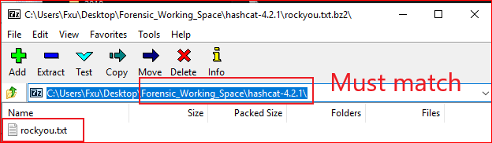
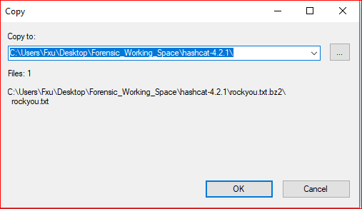

Slide 26
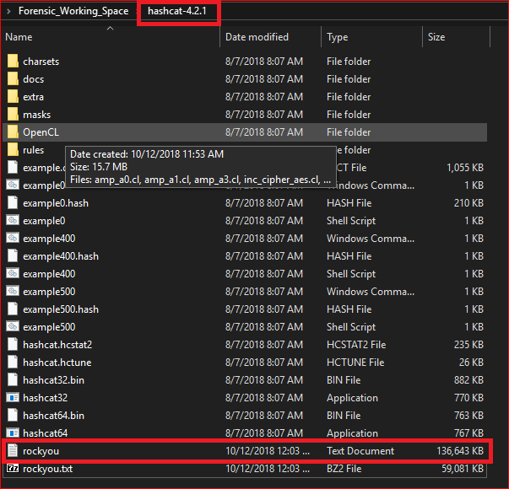
Verify

Slide 27
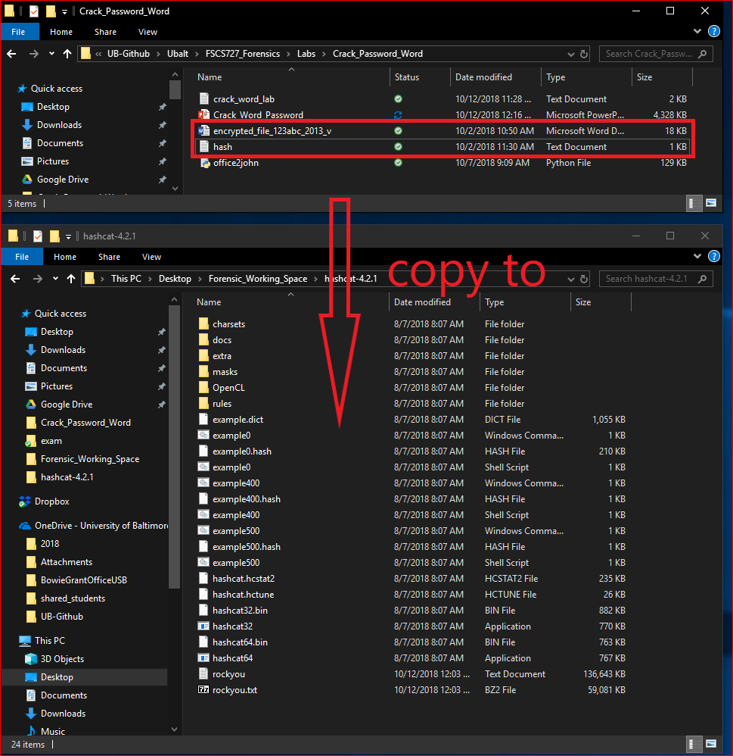

Slide 28
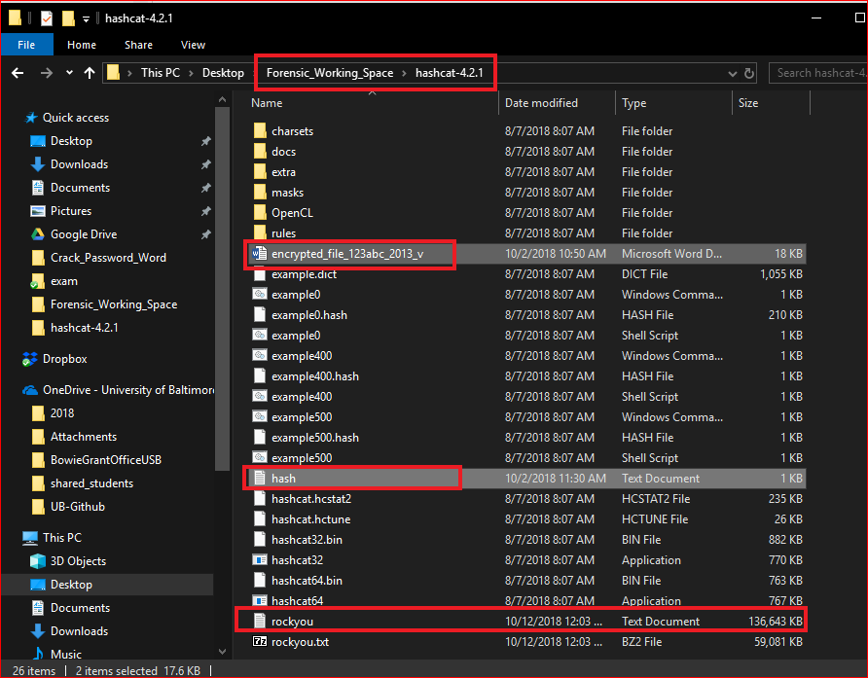

Slide 29
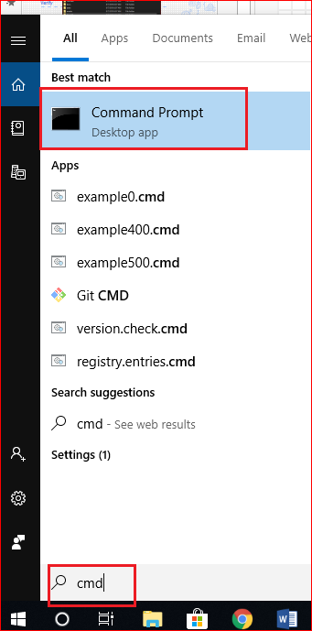
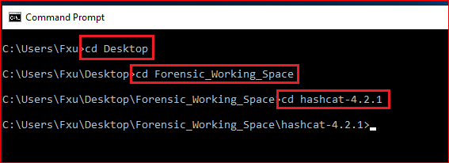

Slide 30
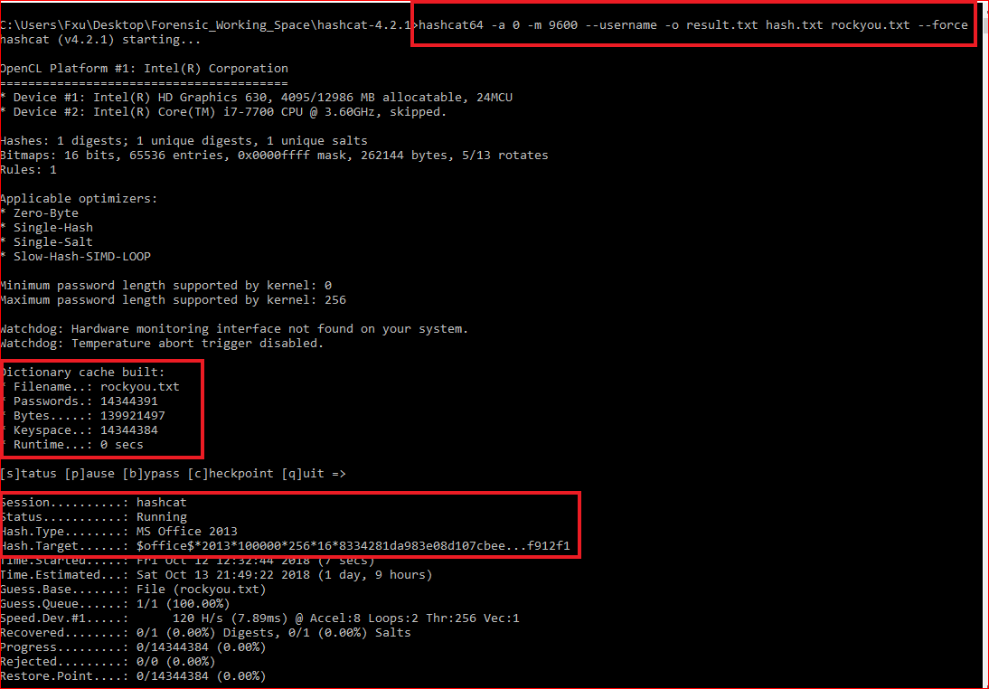
Last step

Slide 31
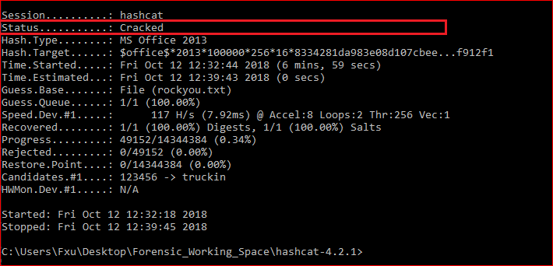

Slide 32
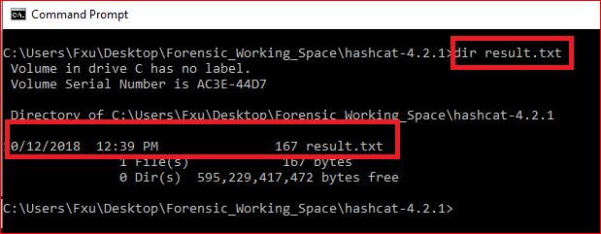
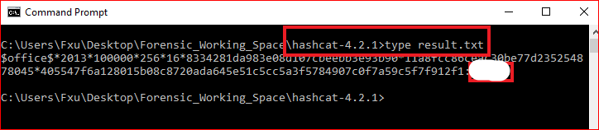

Slide 33
Reference
RC4 tutorial: https://www.youtube.com/watch?v=jjjq41bGzps
https://www.youtube.com/watch?v=lohwg1X0VH8
https://github.com/magnumripper/JohnTheRipper/blob/bleeding-jumbo/run/office2john.py
http://pentestcorner.com/cracking-microsoft-office-97-03-2007-2010-2013-password-hashes-with-hashcat/

Slide 34
Extra credits
https://www.dropbox.com/s/40ak15mk5xr8hvk/how_to_crack_pwd_123.pdf

